Slide 1
Capstone Engagement
Assessment, Analysis, and Hardening of a Vulnerable System

Slide 2
Table of Contents
This document contains the following sections:
01
Network Topology
02
Red Team: Security Assessment
03
Blue Team: Log Analysis and Attack Characterization
Hardening: Proposed Alarms and Mitigation Strategies
04

Slide 3
Network Topology
3

Slide 4
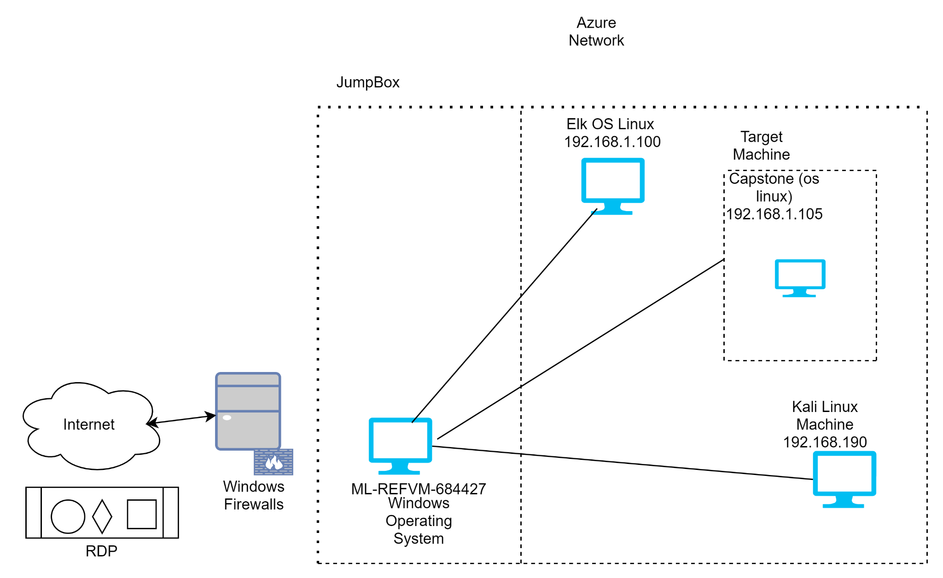
Network Topology
Network
Address Range: 192.168.1.0/24
Netmask: 255.255.255.0
Gateway: 192.168.1.1
Machines
IPv4: 192.168.1.90
OS: Linux
Hostname: Kali
IPv4: 192.168.1.100
OS: Elk stack via vagrant
Hostname: Elk
IPv4: 192.168.1.105
OS: Apache Ubuntu Server
Hostname: Capstone
IPv4: 192.168.1.1
OS: Windows

Slide 5

Red Team
Security Assessment
5

Slide 6
Recon: Describing the Target
Nmap identified the following hosts on the network:
Hostname | IP Address | Role on Network
Windows Azure Lab | 192.168.1.1 | This is the library of different virtual machines that enable the user to perform attacks on target server via an RDP connection
Kali | 192.168.1.8 | This is the "attacking" machine from which the attacker can perform
Capstone | 192.168.1.105 | This is the "web-dav" server that is the "targer" for the attacker to exploit
Elk | 192.168.1.100 | This is used to monitor the overall network and gains data in the form of Filebeat, Metricbeat, packetbeat

Slide 7
Vulnerability Assessment
The assessment uncovered the following critical vulnerabilities in the target:
Vulnerability | Description | Impact
Open Port 80 AKA: CVE-6579 | Since Port 80 is easily open for the attacker, the attacker can easily use a given scanning tool (such as NMAP) to scan the network and gain access to this port. | By doing so, the attacker can gain privileges to execute any commands that allow them access to readily find folders and files within given network.
Directory Indexing Vulnerability | The attacker can access and also download the contents of a given directory that is within a vulnerable network. | The attacker can easily navigate through the directory to find sensitive information such as “secret files” and confidential data.
Discover password using Brute Force | When the credentials of a given system is weak and poorly complex, the attacker can use brute forcing methods which involves continuously attempting several username and password combinations to eventually gain access. | Using tools such as Hydra or John the Ripper, the attacker can gain the credentials of a system and easily login in to access sensitive and unauthorised data.
Remote Code execution (RCE) Vulnerability | This vulnerability when exploited means that the attacker can run any malicious code and run that on the target machine via a PHP script. | By doing this attacker uses a “reverse shell” method to gain access to a particular confidential server without being detected.

Slide 8
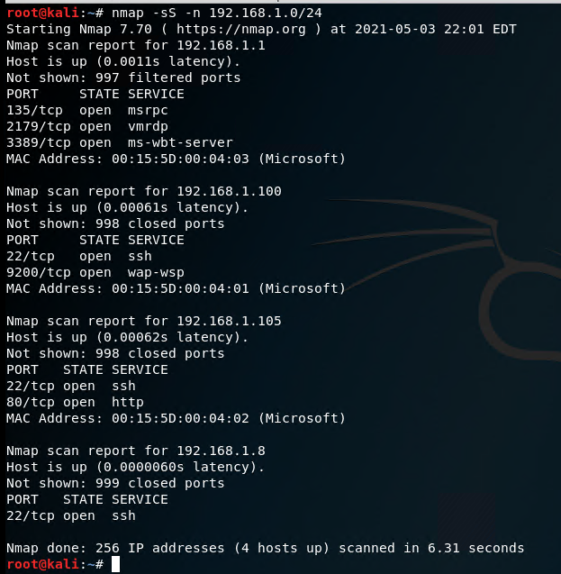
Exploitation: Open port 80
01
02
03
Tools & Processes
Using NMAP scanning tool, the attacker can provide a given IP address range 192.168.1.0/24. By doing this, the attacker can identify which addresses are vulnerable and where port 80 is open.
Achievements
By running this tool, the attacker can understand exactly which system to exploit by gaining its IP address. This provides the first basis of information for the attacker to begin the exploitation.

Slide 9
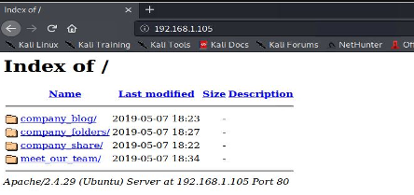
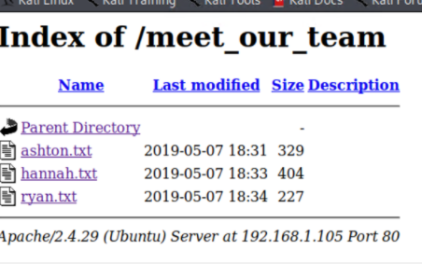
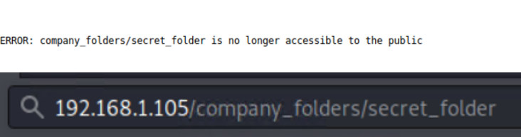
Exploitation: Directory Indexing Vulnerability
01
02
03
Tools & Processes
This vulnerability occurs when the attacker can easily go through a directory and gain its contents. The process of this exploit is that the attacker can easily browse through the directory and find locations of secret folders.
Achievements
Once the locations of these secret folders are found, the attacker can then simply type that location path into the URL to gain access to this secret directory. This is how the secret folder for the vulnerable web server was found.

Slide 10
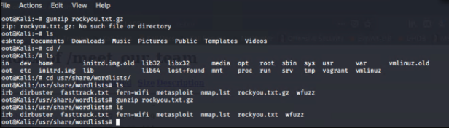
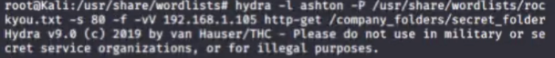
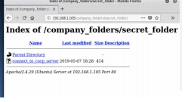
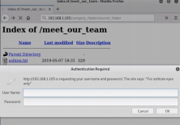
Exploitation: Discover Password using Brute Force
01
02
03
Tools
Using the tool “Hydra” the attacker can brute force for the secret folder credentials by
checking combinations against predetermined wordlist called
“rockyou.txt”. The attacker can go to the location of this file and type this command for
exploitation: hydra -l ashton -P rockyou.txt -s
80 -f -vV 192.168.1.105 http-get
/company_folders/secret_folder
Achievements
This exploit as a result gives the username and password which is confirmed as “ashton” and “leopoldo” respectively. Using this, the attacker can easily type these credentials into the secret folder login to ultimately gain access.

Slide 11

Blue Team
Log Analysis and Attack Characterization
11

Slide 12

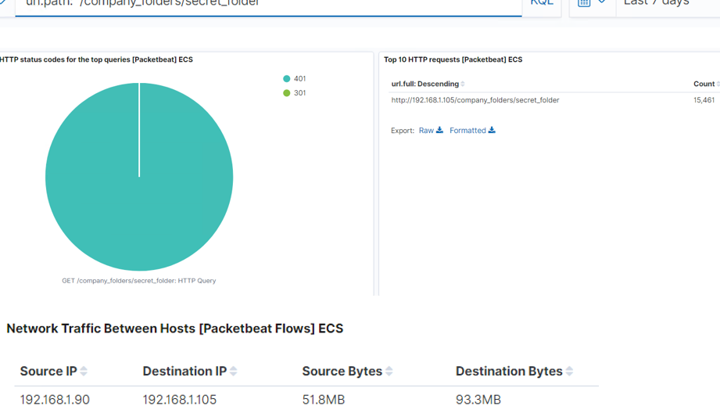
Analysis: Identifying the Port Scan
Answer the following questions in bullet points under the screenshot if space allows. Otherwise, add the answers to speaker notes.
What time did the port scan occur? 3am
How many packets were sent, and from which IP? 15461 from 192.168.1.90
What indicates that this was a port scan? Multiple ports requested from same IP address

Slide 13
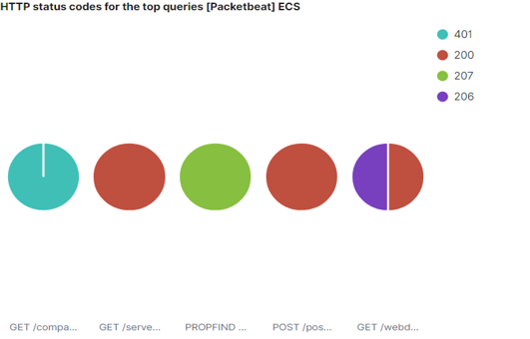
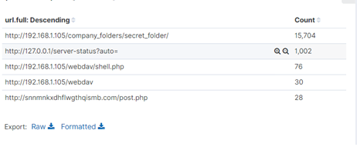
Analysis: Finding the Request for the Hidden Directory
Answer the following questions in bullet points under the screenshot if space allows. Otherwise, add the answers to speaker notes.
What time did the request occur? 0300
How many requests were made? 10 urls requested during the attack 192.168.1.105
Which files were requested? What did they contain? Company_folders/secret_folder ( Hash code password for user Ryan)

Slide 14
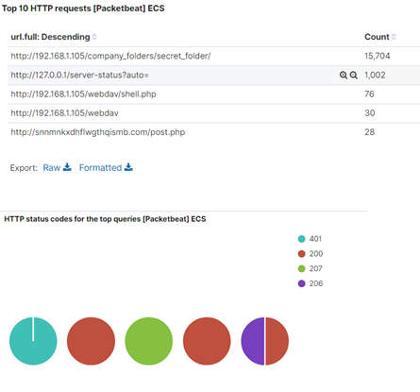
Analysis: Uncovering the Brute Force Attack
Answer the following questions in bullet points under the screenshot if space allows. Otherwise, add the answers to speaker notes.
How many requests were made in the attack?15704
How many requests had been made before the attacker discovered the password? 15703

Slide 15
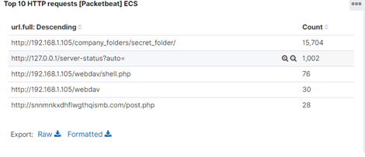
Analysis: Finding the WebDAV Connection
Answer the following questions in bullet points under the screenshot if space allows. Otherwise, add the answers to speaker notes.
How many requests were made to this directory? 15704
Which files were requested? The shell.php file was requested 76 times

Slide 16
Blue Team
Proposed Alarms and Mitigation Strategies
16

Slide 17
Mitigation: Blocking the Port Scan
What kind of alarm can be set to detect future port scans? Set an alarm for future unauthorized access. Report number of times secret_ folder is accessed from external IP. Send alert and email of log when access is detected.
What threshold would you set to activate this alarm? Configure a file that will be modified to prevent unauthorized access to the secret_folder, remove this directory and file completely.
What configurations can be set on the host to mitigate port scans? Making sure that there are regular checks and scans actively on system ports to detect whether there are any unnecessary ports open.
Describe the solution. If possible, provide required command lines.
Allow only certain MAC and IP addresses to connect to the necessary ports and gain access to company network.

Slide 18
Mitigation: Finding the Request for the Hidden Directory
What kind of alarm can be set to detect future unauthorized access? Making sure that users cannot easily request for hidden directories without proper authentication in place. An alarm can be set to make sure that malicious users don’t bypass authentication
What threshold would you set to activate this alarm?
Setting a threshold of the number of requests made to a given path. Making sure there is only a maximum of 3-5 requests to a hidden directory within an hour or thirty mins
What configuration can be set on the host to block unwanted access?
Making sure that all the data within folders are encrypted securely.
Avoiding obvious directory names or easily identifiable clues for a malicious user to reconnaissance
Ensuring that the secret and authorised files are not easily found by the general public and hiding them securely.

Slide 19
Mitigation: Preventing Brute Force Attacks
What kind of alarm can be set to detect future brute force attacks? Alert email and log when on protected files and folders. Error (401) response occur at any or okay responses occur from a non trusted IPS
What threshold would you set to activate this alarm?
Identifying whether there is a malicious user trying to gain access to authorised files can be determined through the excessive number of Login failures to the system. Therefore, making sure that there is a minimal baseline for the number of login attempts such as a limit of 5 attempts allowed, can minimise and help detect malicious users.
What configuration can be set on the host to block brute force attacks? Using multi-factor authentication methods
Setting a timer for users’ session and automatically logging out of the system
Setting strong password policies to ensure the the credentials cannot be easily breached via bruteforce.
Strong password policy against a brute force attack. Locking out user after multiple failed login attempts. Security questions that identify the person is a human and not system

Slide 20
Mitigation: Detecting the WebDAV Connection
What kind of alarm can be set to detect future access to this directory? Alarm should be set to detect for future unauthorized access to this directory. Report number of times directory is requested from non-trusted IPs. Alert when email or log when requests are made on protected files, folders and non-trusted IPs
What threshold would you set to activate this alarm?
The threshold to set to activate the alarm can be if there is any requests that differ from the baseline HTTP GET request eg. HTTP PUT or if its from an untrusted malicious IP.
What configuration can be set on the host to control access? When navigating to the directory they should allow the IP address from 192.168.1.1, 192.168.1.105 and 127. Then deny from all directory
Ensuring that there is an authentication prompt to make sure that trusted users have to enter their credentials to login
Making sure that these usernames and passwords have a high level of complexity

Slide 21
Mitigation: Identifying Reverse Shell Uploads
What kind of alarm can be set to detect future file uploads? Ensuring that there is an alarm set when there are multiple requests trying to access port 4444. In addition to this, setting an alarm that detects if there are any sort of uploads such as a .php file within the server.
What threshold would you set to activate this alarm?
Making sure that there is a threshold of only 1 request allowed to port 4444. If there are requests that exceed this, the alarm should notify users that there is a potential malicious user
What configuration can be set on the host to block file uploads?
Only allow trusted IP addresses to access the connection
Changing the permissions of users to make sure that they only have “read-only” access instead of “write”.
Ensuring that uses cannot edit or upload any payloads in the server.

